Slide 1

TEAM 2 Sprint 3 Presentation
BY
Zaid Ansar
Muhammad Sameer
Minhad Mahmud
Ahmed Ahmed
Kaleb Bekfekadu

Slide 2
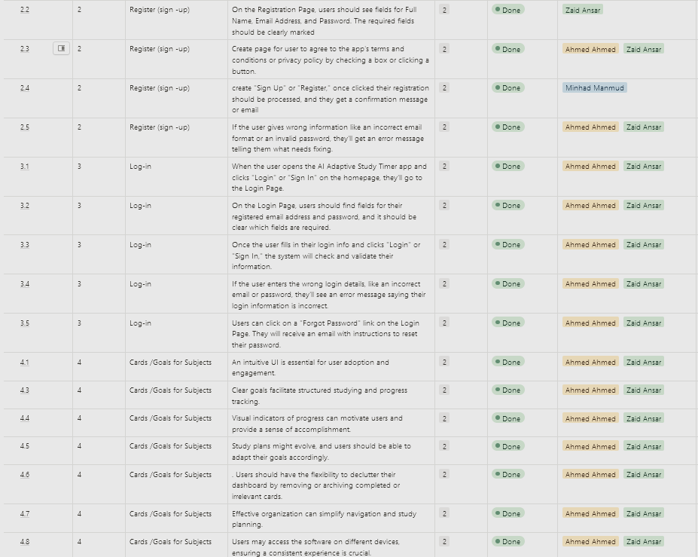
Project Backlog
Our backlog progress has been substantial, with completed tasks in registration, user interface improvements, and ongoing subject-specific feature development. These achievements have enhanced user onboarding and overall usability. We're focused on addressing pending tasks to further strengthen the study tool.

Slide 3

Issues and Solutions
Exporting from Figma to Bubble: Trouble exporting design assets from Figma. Solution: Collaborate with Figma and Bubble experts for a smoother export process.
AI: Challenges in implementing AI features. Solution: Seek AI expertise and explore ChatGPT AI API for faster integration.
Working on the interface: Designing a user-friendly interface. Solution: Conduct user testing and iterate based on feedback.
Google Calendar Integration: Scrapping Google Calendar integration. Solution: Consider alternative scheduling solutions or integrate with other calendars.

Slide 4
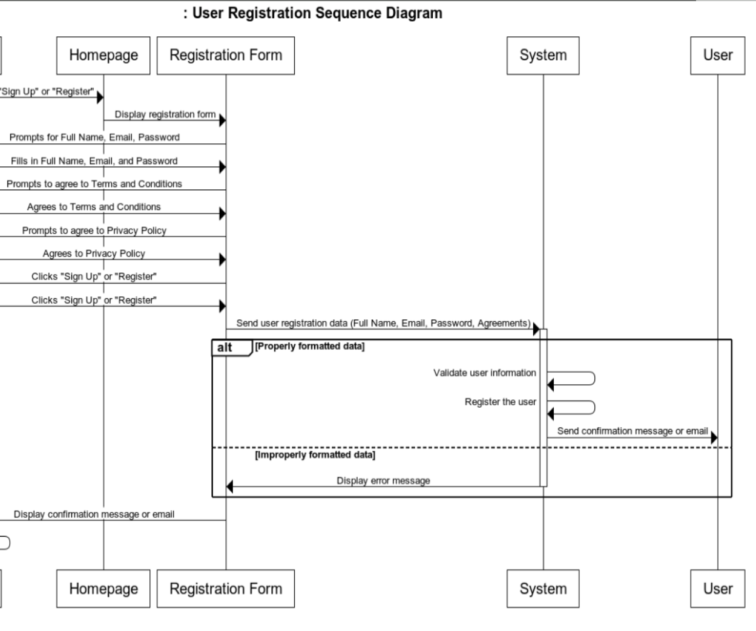
Sequence diagrams
Explanation: Sequence diagrams play a key role in ensuring logical flow and clarity in our software design and testing processes.
Use Cases: We've applied sequence diagrams to scenarios like user registration, study cards, and study goals.
Benefits: Sequence diagrams help us maintain logical consistency, enhance user experiences, and provide a solid foundation for effective test cases.

Slide 5

Current Progress
Trained AI to detect over-commitment and under-commitment in study goals, with suggestions for sustainable alternatives.
Designed an interactive UI that highlights AI suggestions and prompts for user understanding and action.
Enabled AI to interpret and understand course syllabuses, providing topic-specific suggestions.
Ensured AI adapts to different learning speeds and styles, offering tailored advice.
Organized goals and subgoals in a neat, folder-like structure for improved clarity and organization.
Implemented the ability to set deadlines and priorities for both major goals and subgoals.

Slide 6


Thank You
Any Questions ? Send them at msameer1@student.gsu.edu

